Slide 1


JavaScript OOP: Course Introduction
Course Program, Evaluation, Exams, Resources
JavaScript OOP
Telerik Software Academy
http://academy.telerik.com

Slide 2

Table of Contents
What is next in the Academy?
The JavaScript OOP Course Program
Exams and Evaluation
Standard Criteria
Resources for the Course
Software

Slide 3

JavaScript OOP
About to make the next step

Slide 4

What's Coming Next?
JavaScript OOP
Continuation of JavaScript Fundamentals
Diving into design of modern JS apps
Pretty much the same
Lectures 2 times a week
Practical exam after a month
The course exam
Solve/extend one or more tasks

Slide 5

JavaScript OOP: Course Program
Material to cover during the course

Slide 6
JavaScript OOP: Course Program
"JavaScript OOP" course introduction
Course Program, Exams, Evaluation
Functions and Function Expressions
Advanced topics about functions
Immediately-invoked function expressions
Introduction to Unit testing
With Mocha.js and Chai.js
Scopes and Closures
Function and global scope

Slide 7


JavaScript OOP: Course Program (2)
Classical OOP and inheritance in JavaScript
Function constructors
Methods and fields
Getters and setters
Hidden/public data
Implementing inheritance in JS
The prototype chain

Slide 8
JavaScript OOP: Course Program (3)
Prototypal inheritance
Inheriting objects, instead of functions
Object and Object.prototype methods and properties
Object#keys, Object#create, etc..
Modules and Patterns in JavaScript
Modules
Revealing Module pattern

Slide 9
JavaScript OOP: Course Program (4)
Creating and Using Exceptions
Try-catch blocks
Using built-in exceptions
Creating custom exceptions
ECMAScript 6 classes & inheritance
Using the features of the next version of JS
Exam preparation
Solving tasks for the exam
Practical exam – 9 July 2015

Slide 10
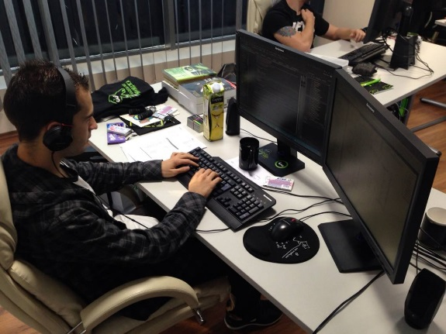
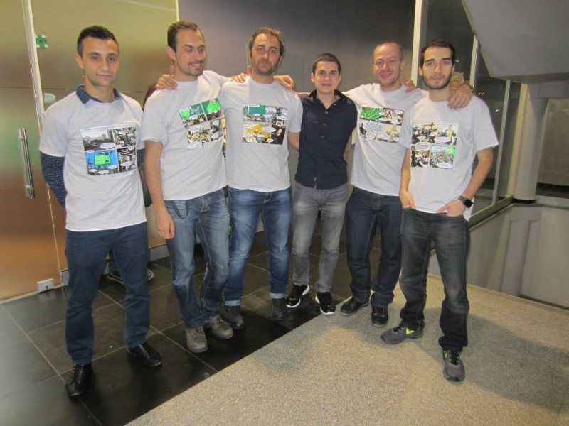
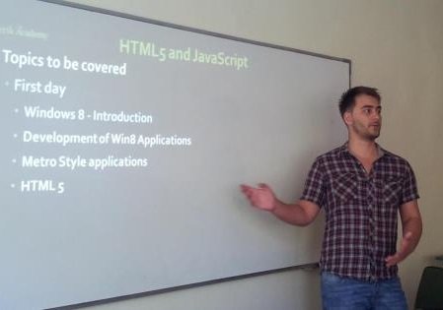
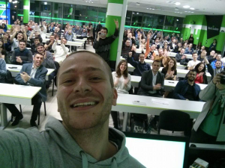
Trainers Team

Slide 11
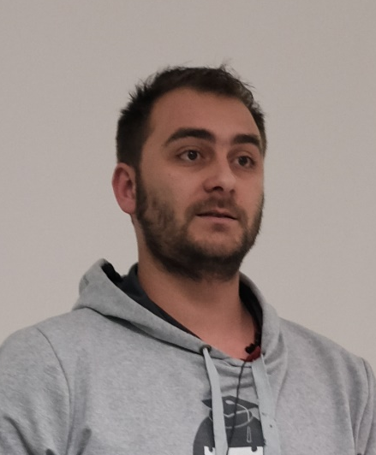
Lead Trainer
Doncho Minkov
Senior Technical Trainer @ Telerik Software Academy
Contestant in the Informatics competitions
Champion from Telerik Software Academy
Experience with Web and Mobile apps
Proficient with JavaScript and .NET
Email: doncho.minkov [at] telerik.com
Blog: http://minkov.it
GitHub: https://github.com/Minkov

Slide 12

Deputy Trainer
Evlogi Hristov
Technical Trainer @ Telerik Software Academy
Graduate from the fourth season of Telerik Software Academy
Ex-developer, Sharepoint
E-mail: evlogi.hristov [at] telerik.com

Slide 13

Trainers
Nikolay Kostov
Manager Software Engineering @ Telerik (Progress)
Microsoft Certified Trainer (MCT)
Champion from Telerik Academy
IT and Informatics competitions winner
Student in Sofia University (Computer Science)
Email: nikolay.kostov [at] telerik.com
Blog: http://nikolay.it
GitHub: https://github.com/NikolayIT

Slide 14
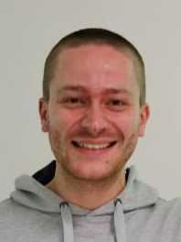
Trainers
Ivaylo Kenov
Technical Trainer @ Telerik Academy
Mathematical competitions contestant
Champion from Telerik Software Academy
E-mail: ivaylo.kenov [at] telerik.com
Champion in OOP and DSA
Blog: http://ivaylo.bgcoder.com/
GitHub: https://github.com/ivaylokenov

Slide 15
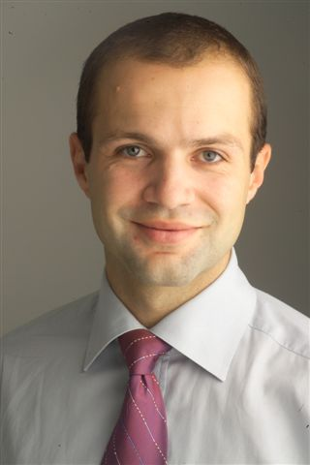
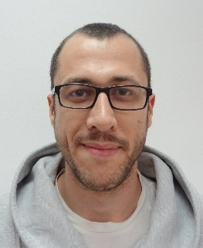
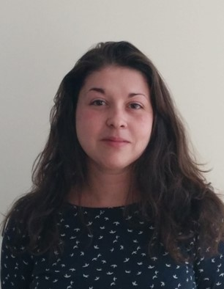
Telerik Academy Team
Martin Milanov
Director of Telerik Academy
Zdravko Georgiev
Web developer
Yana Lukanova
Administrative and organizational specialist

Slide 16





Evaluation
Thank God There Are Bonuses!

Slide 17
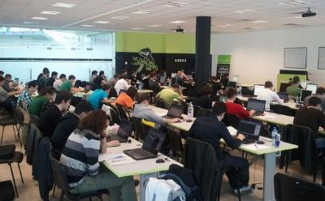

JavaScript – Evaluation
Evaluation components
Practical exam – up to 75%
Homework – up to 10%
Attendance in class – up to 5%
Forum activity – up to 5%
Helping other students – up to 5%

Slide 18
Homework Peer Reviews
Homework tasks will be revealed on the day of the first delivery of the presentation
Deadline will be 1 week from the second delivery of the presentation
For each task students will have a set of unit tests that the solution must pass exactly
Homework will be submitted in http://bgcoder.com
The tests will be implemented using Mocha.js and Chai

Slide 19








Resources
What We Need in Addition to this Course Content?

Slide 20
JavaScript Resources
Mozilla Development Network (MDN)
https://developer.mozilla.org
Mostly used for the presentations
Books:
Secrets of the JavaScript Ninja
JavaScript: the Good parts

Slide 21
Course Web Site & Forums
Register for the "Telerik Academy Forums":
Discuss the course exercises with your colleagues
Find solutions for the exercises
Share source code / discuss ideas
The JavaScript Fundamentals official web site:
telerikacademy.com/Forum/Category/28/javascript-oop
http://academy.telerik.com/student-courses/web-design-and-ui/javascript-oop

Slide 22
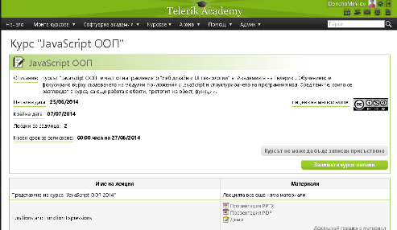
Telerik Integrated Learning System (TILS)
The Telerik Integrated Learning System (TILS)
www.telerikacademy.com
Important resource for all students
Homework submissions
Homework peer reviews
Presence cards with barcode
Reports about your results
telerikacademy.com/Courses/Courses/Details/245

Slide 23


Required Software
Software needed for this course:
Microsoft Visual Studio Code
Microsoft Visual Studio 2013 or Visual Studio Community 2013 (free version of VS 2013) are also good enought
Sublime Text 2/3
JetBrains WebStorm

Slide 24



JavaScript OOP Course Introduction
http://academy.telerik.com

Slide 25



Free Trainings @ Telerik Academy
Web Design and UI Technologies @ Telerik Academy
html5course.telerik.com
Telerik Software Academy
academy.telerik.com
Telerik Academy @ Facebook
facebook.com/TelerikAcademy
Telerik Software Academy Forums
forums.academy.telerik.com

